Slide 1
DL Sprint 4.0 at BUET CSE Fest 2026
Bangla Diarizz & Bengali ASR
Team EnviSage
Nabil Shad Rahman, Shamim Hasan, Sadia Afrin Anika, Sojib Roy

Slide 2

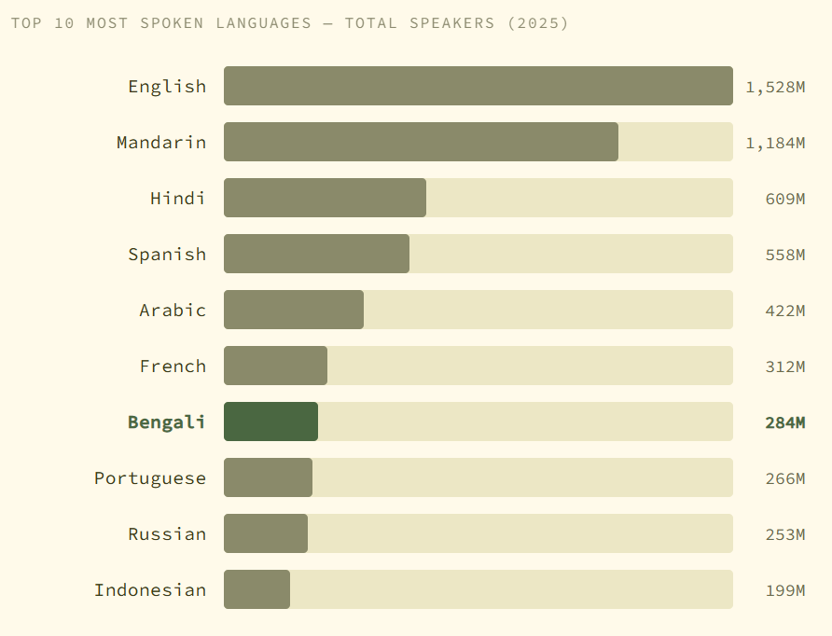
DL SPRINT 4.0 · BUET CSE FEST 2026
Background
Existing Work
Whisper, Wav2Vec, MMS
Great performance on high resource languages
What about Bangla?
7th most spoken language, severely underrepresented
Only ~1500 hours of labelled data. English has 10,000+
Variety of dialects, language complexity
March 6, 2026 · Background

Slide 3
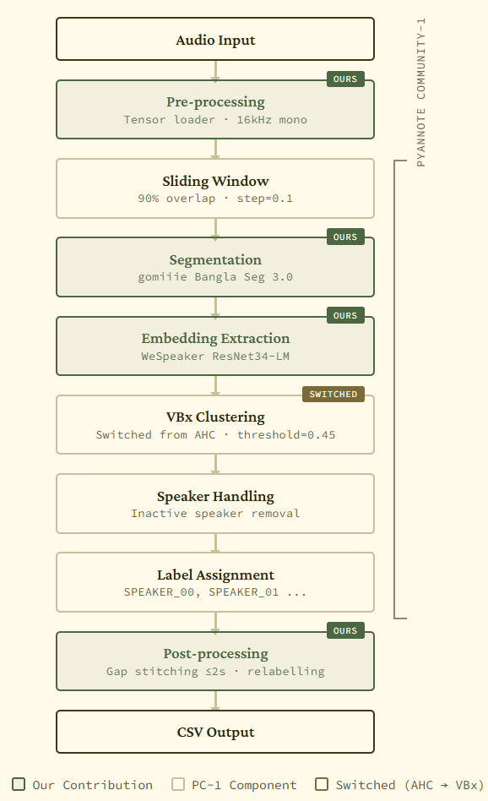
DL SPRINT 4.0 · BUET CSE FEST 2026
Bangla Diarizz
Pyannote Community -1
Modular architecture
Provides audio validation, sliding window, PLDA scoring internally
Built in optimized clustering - VBx, AHC, Spectral.
Segmentation
Language Dependent
Fine-tuned Pyannote Segmentation 3.0 on competition training data (gomiiie 3.0)
Swapped the default one with our model
March 6, 2026 · Bangla Diarizz

Slide 4
DL SPRINT 4.0 · BUET CSE FEST 2026
Bangla Diarizz
Embedding
Replaced with WeSpeaker ResNet34-LM
Produces tighter, well separated clusters
Clustering
Switched to VBx, performed better than AHC
Better for multiple speakers
March 6, 2026 · Bangla Diarizz

Slide 5
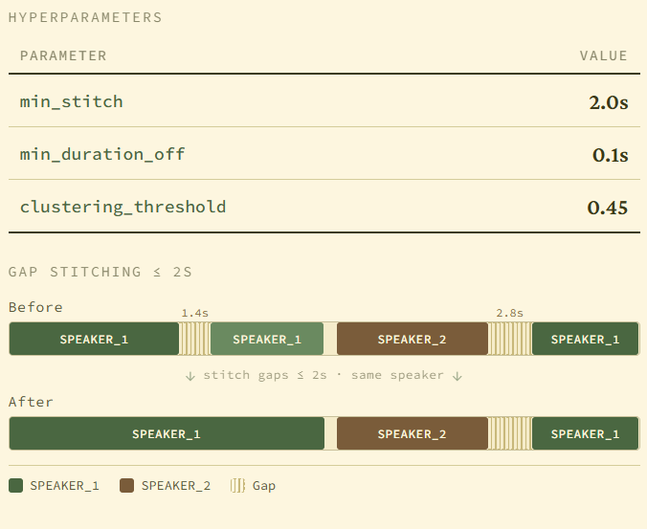
DL SPRINT 4.0 · BUET CSE FEST 2026
Bangla Diarizz
Pre & Post Processing
Pyannote loads and validates audio from disk on every internal access
Loading as preprocessed tensor cut inference time from 1 hr 22 mins to 35 mins
Relabel speakers in order of first appearance
Stitch same speaker gaps of <= 2s
March 6, 2026 · Bangla Diarizz

Slide 6
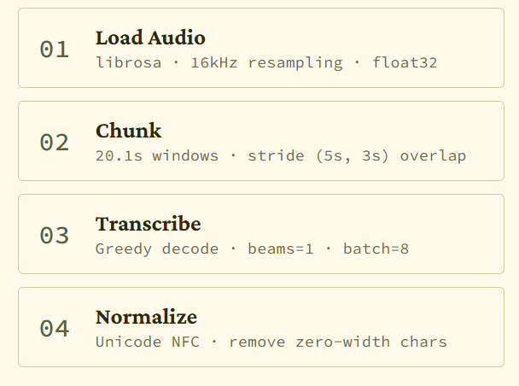
DL SPRINT 4.0 · BUET CSE FEST 2026
Bangla ASR
Approach
Built on top of the starter notebook, which uses tugstugi Whisper-Medium
Changed chunk size to 20.1s from default 30, prevents word drops at boundaries
5s left, 3s right stride, better for whisper’s left to right decoding
Unicode Normalization, prevents WER due to multiple representations for the same character
Batch Size = 8, reduced inference time significantly
March 6, 2026 · Bangla ASR

Slide 7
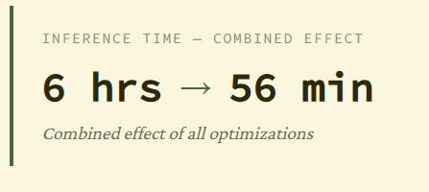
DL SPRINT 4.0 · BUET CSE FEST 2026
Bangla ASR
Decoding Changes
Switched to greedy decoding(num_beams = 1)
Showed a moderate increase in accuracy (~36% WER)
Temperature = 0.0, sample = False
Becomes more deterministic, chooses the output with highest probability, reducing randomness
March 6, 2026 · Bangla ASR

Slide 8
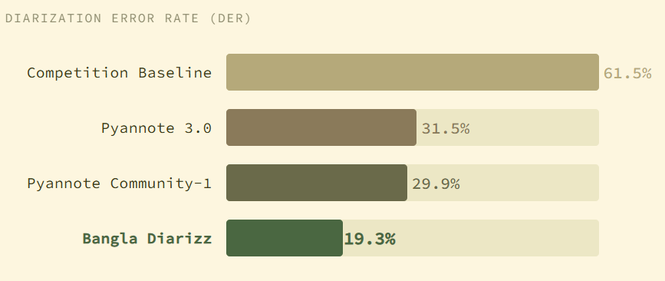
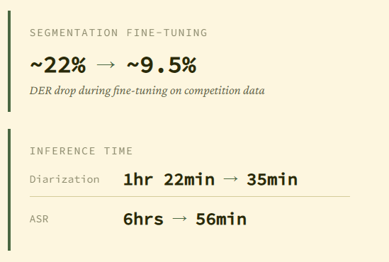
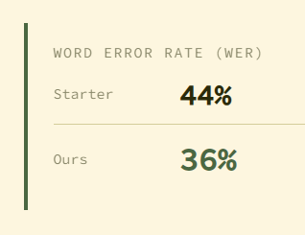
DL SPRINT 4.0 · BUET CSE FEST 2026
Results and Benchmarks
March 6, 2026 · Results and Benchmarks

Slide 9
DL SPRINT 4.0 · BUET CSE FEST 2026
Future Work
Preprocess with a source separation model (e.g. Demucs)
The embedding model is language agnostic
Can be finetuned on Bengali specific data
Analyse VBx cluster quality to identify sources of speaker confusion, find where speaker confusion occurs and take according steps
More Data - creating more labelled datasets and training on them
March 6, 2026 · Future Work

Slide 10
DL SPRINT 4.0 · BUET CSE FEST 2026
Conclusion
Bangla Diarizz is a modified, finetuned version of Pyannote Community-1
The segmentation model is adapted to Bangla, but the embedding model is language agnostic
19.264% DER, down from 41%, ~56% reduction in inference time
Bengali ASR achieved a 36.1% WER and 6x faster inference time using greedy decoding
This is a drop in the ocean in hopes of increasing work for Bangla-specific speech technology
March 6, 2026 · Conclusion

Slide 11
DL SPRINT 4.0 · BUET CSE FEST 2026
THANK YOU
Any Questions?
March 6, 2026 · Closing

